Slide 1
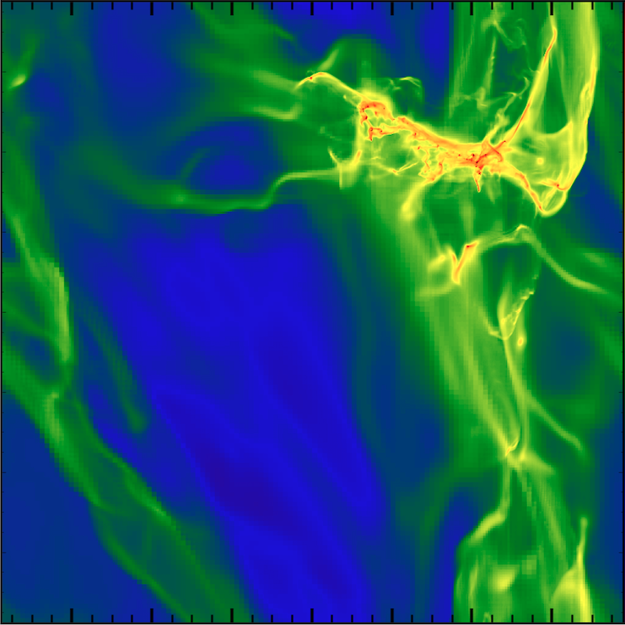
Turbulent Star Formation In Gravitationally Bound Clouds
Daniel Murray
Notes:
Random motions run gas together causing shocks (if cooling is <<t dyn the gas cools rapidly and compresses). Creates that filamentary structure.
Cooling timescale is ~1000years really short.

Slide 2
Outline
Phenomenology of Star Formation
Analytic Theories of Star Formation
Numerical Simulations and Results
Hydrodynamics
Hydrodynamics plus proto-stellar jet feedback
Conclusions

Slide 3
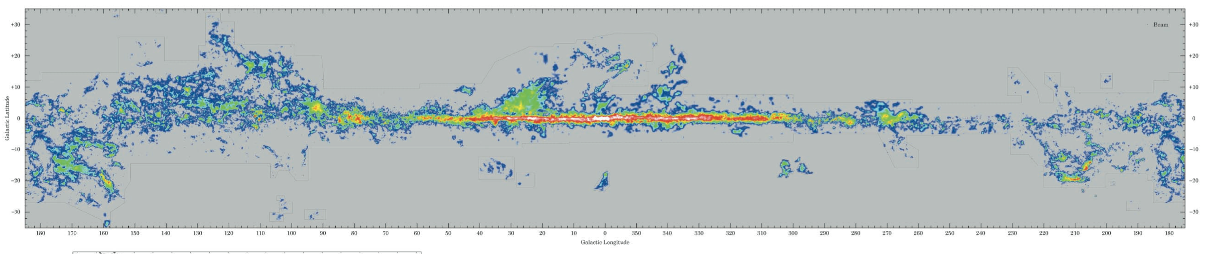
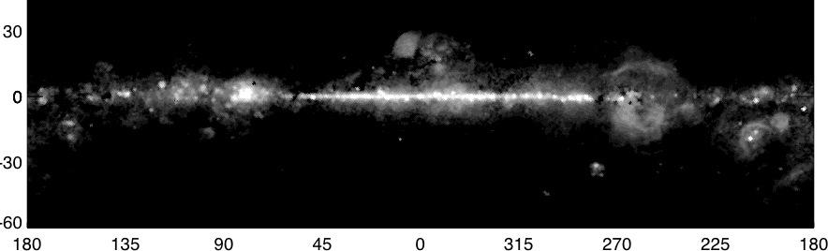
Where do Stars form?
Dame et al. (2001) ApJ 547 792
Notes:
Top image is CO, which is associated with cold (20k) dense gas. From the Dame survey
Bottom is free free emission from Wmap (radio frequencies): traces ionizing radiation from photons (h ionized) from O stars
Correspond to the bright spots of cold gas in top image.
LMC and SMC

Slide 4
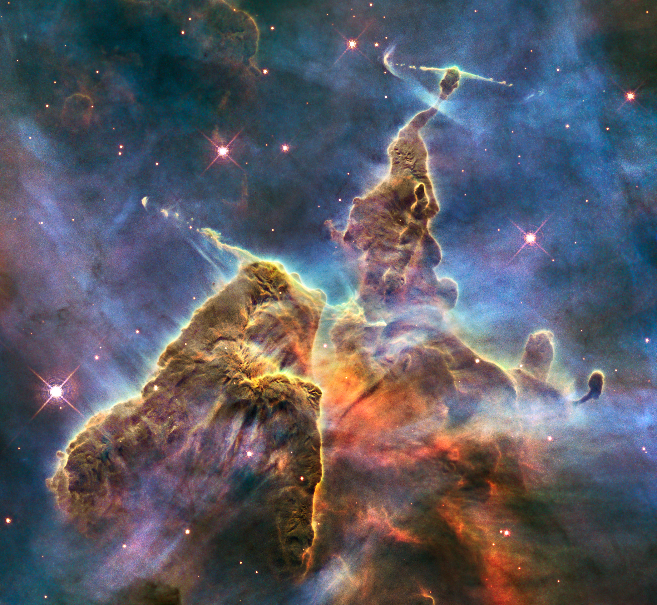
Stars form in Giant Molecular Clouds
Milky Way Galaxy is ~50-50 atomic to molecular gas inside solar circle
Stars have only been seen forming in molecular gas
Most stars form in the most massive clouds
Giant Molecular Clouds have virial parameters of order unity (gravitationally bound)
The gas in these clouds is seen to have highly supersonic turbulence: Mach 10 – 20 (e.g. Liszt et al. 74)
Relation between Cloud size and line-width: attributed to turbulence (Larson 81)
Carina Nebula
Notes:
This is the dregs of a GMC, being destroyed by feedback processes.
The blue wispy stuff is photo-ionized gas coming of the dust & gas cloud because its ionized and overpressured (heated up) by big O-stars off camera.
Gas dust ratio is 100:1 (from the metalicity in the Milky Way galaxy being of order solar (~2%)
Most of those metals are trapped in dust grains, the carbon and oxygen tend to form CO and that’s the tracer we use can see the molecular gas
Galaxy atomic mass is 2e10 Msun vs 1.6e9 Msun molecular gas
Virial parameter (kinetic energy over gravity)
The larger the cloud the larger the turbulence.

Slide 5
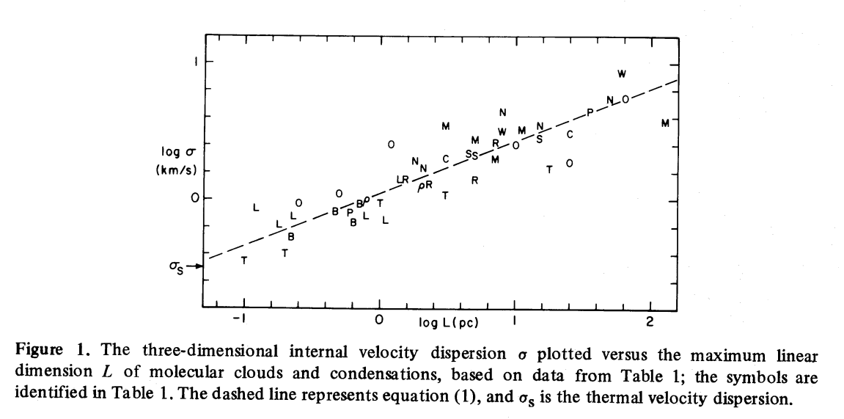
Cloud Size, Line-width Relation
Larson 1981
Scaling is:
Velocity dispersion size
Notes:
Velocity Dispersion decreases with decreasing radius
Consistent with, or evidence that the ISM is turbulent
Physical interpretation, it’s a turbulent cascade, like the kolmogoroff cascade (only in this case supersonic)
Larson found 0.38, later better observations found it to be more ~0.5
Note at 1km/s in the line-width matches with 1 parsec in length. Up at ~ 8 km/s gets out to ~100parsecs, but the key is that the relation is there
His c_s is the sigma s at ~0.5 -> 0.3 km/s
This is turbulence because it cascades down to smaller lengthscales.
However, this trend can be reversed by adiabatic heating.
Also, our sound speed is ~0.254 km/s so the 1 km/s is ~ 5 Mach.

Slide 6
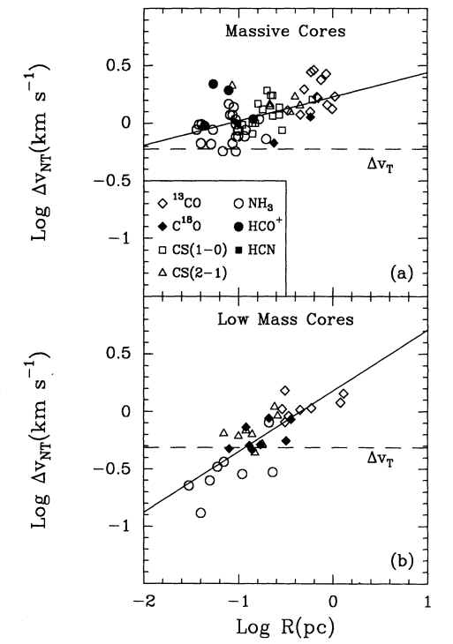
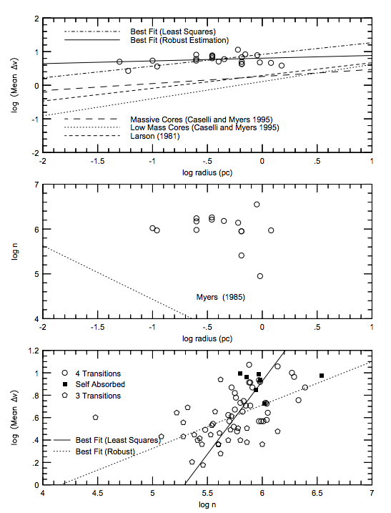
Deviations from Larsons Law
Caselli & Myers 1995
Plume et al 1997
Velocity is not given by Larson’s law for massive cores
Notes:
Caselli & Myers 95: Noted the deviation from Larson’s law in high mass cores. Note its more flat.
Plume 97 observation paper noticed a flatter power law than Larson’s r^(1/2), instead it looked more like 0.2 or a ¼
Caselli Myers fig 2 the full-width half max is like 3 km/s
Plume Plot 3 -> Note that they say that the turbulent velocity increases with density, (i.e v_t increases with decreasing r)

Slide 7
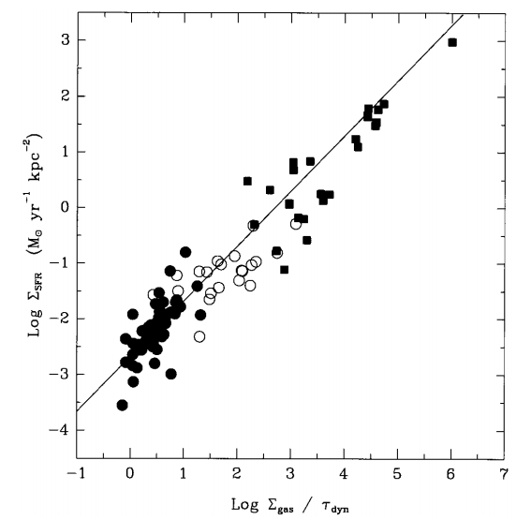
How fast do stars form?
Given by Kennicutt-Schmidt law on galaxy scales
Naively
Where:
Instead:
Star formation is slow !
Kennicutt 1998
Notes:
Kennicutt is for Galaxies. Marginally stable disk t_dyn ~ t_ff
Why would eta be ~1? If gravity is dominating then you would expect it to collapse in the free-fall time
Slope is 1 (says model should be ok), note that the 0 of the x-axis intersects the line at ~ few by 10^-3

Slide 8
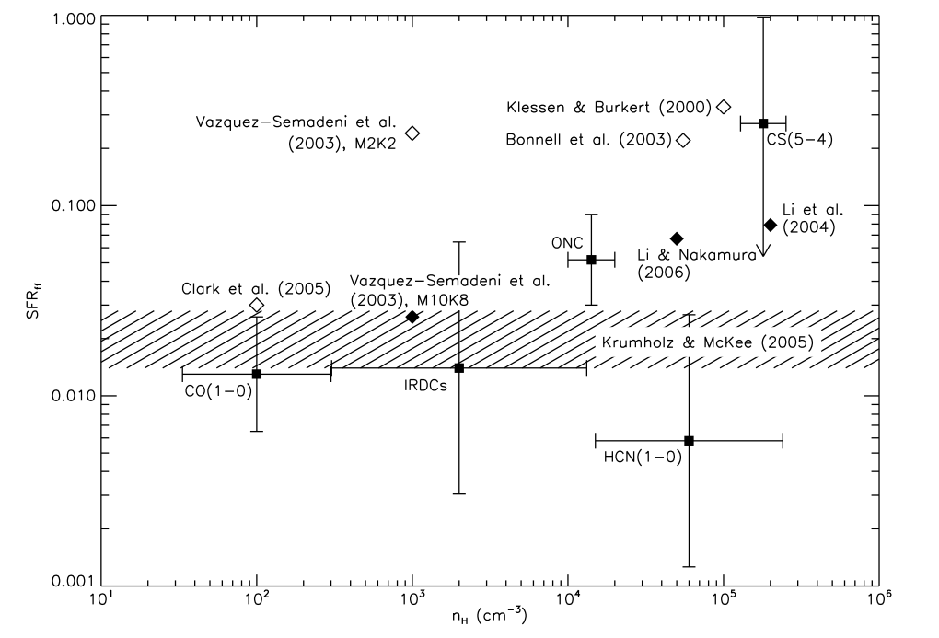
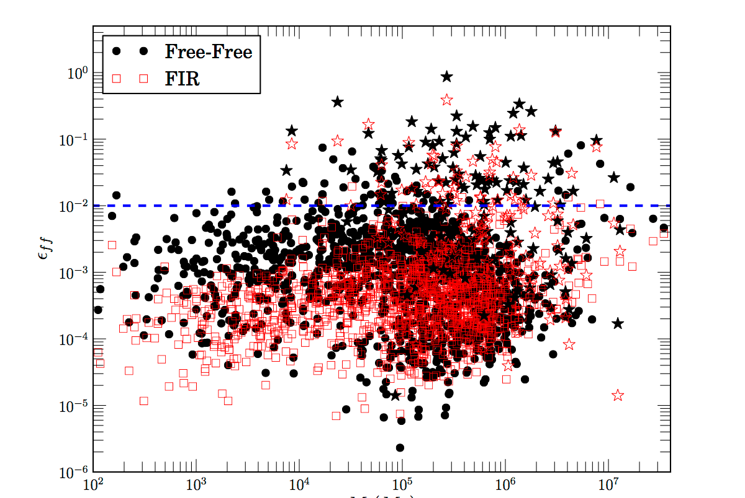
Is star formation slow on GMC or smaller scales?
Krumholz & Tan (2007) ApJ 654 304
Mivelle-Deschenes, Murray, & Lee (2016)
SFE independent of density
Claim little scatter in SFE
Large scatter in SFE vs GMC mass
Notes:
But the plot has scatter, so it doesn’t really support the papers claim of little scatter.

Slide 9
Why is Star Formation so slow?
Thermal pressure support HSE (Larson 69; Penston 69; Shu 77)
Magnetic pressure support
Turbulent pressure support HSE (Myers; McLaughlin; McKee & Tan)
Turbulence (Padoan & Nordlund; Krumholz & McKee)
Stellar Feedback
Notes:
C_s support HSE not enough mass accretion to form the most massive stars before their lifetime ends.

Slide 10
Early analytic theories of star formation
Larson 69; Penston 69
2 equations Mass and Momentum conservation
Energy eqn replaced by isothermality P = ρc_{s}²
BC’s u_{r} = 0 at r = 0 and u_{r} = ∞ at r = ∞
Shu 77
BC’s u_{r} = ∞ at r = 0 and u_{r} = 0 at r = ∞
Cannot form the most massive stars
Notes:
Larson did a static cloud, Penston did a nearly static cloud (Bonner-Ebert sphere)
Assume self similarity, which gives a power law throughout, but this doesn’t hold later.
In Larson BC you can’t have the velocity be inf at r inf, as there must be some boundary to the cloud.
In Shu boundary conditions, you have a shock at the surface/ at r =0 which is not modeled by these equations.
The Mass accrection rate is too small to form the most massive stars (M_solar per Megayear)
40 M solar stars go supernova in ~4 million years. That takes 4 million years to reach 16 M solar. So how do we get more massive stars?

Slide 11
Myers & Fuller 92; McLaughlin & Pudritz 97; McKee & Tan 03
Turbulent Core Model
The sound speed c_{s} -> turbulent velocity v_{T}
Allow for faster propagation on information -> faster accretion rate -> can form massive stars.
Turbulent velocity is fixed as function of time.
Notes:
These large GMC’s are very turbulent, with Mach’s between 5 and 20 as mentioned earlier. So, the turbulent velocity is a great way to transmit the collapse information.

Slide 12
Murray and Chang 15
Turbulent closure model
Use mass, momentum conservation and:
Robertson & Goldreich 2012
Essentially, it physically means:
Also define r* to be a physical scale
Notes:
Everyone else has closed the equations at the momentum equation. Murray&Chang close at energy equaiton
Robertson&Goldreich eqn is a toy model of the evolution of the turbulent velocity
This modified energy equation: first 2 terms are the Lagrangian derivative. The first term in the brackets is the turbulent driving produced by infall and the second is the standard turbulent decay rate, where eta ~ 1
i.e. v_t ~ abs(u_r)
If you collapse the cloud rapidly (faster than the decay time of the turbulence) then you have more energy at the smaller length scale. This slows down the collapse, which allows the turbulent velocity to decay, which allows the collapse to speed up, which pumps up the turbulent velocity. So that feedback loops with itself causing: v_T ~ u_r

Slide 13
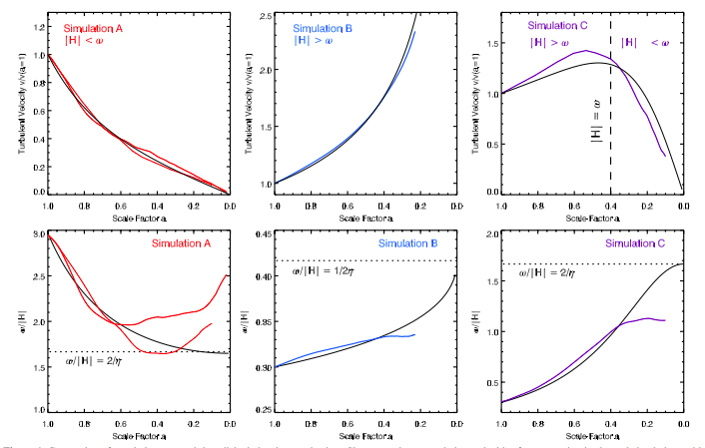
Adiabatic Heating in Turbulence
Robertson & Goldreich 2012
Notes:
Scale factor -> time increasing to the right
Dotted lines are theoretical prediction of what the equilibrium would be if you had enough time.
H -> u_r/r w -> v_T/r for us.

Slide 14
Predictions of Murray and Chang 15
Density is an attractor solution for small r
Velocity scaling:
Mass in stars scales like t²

Slide 15
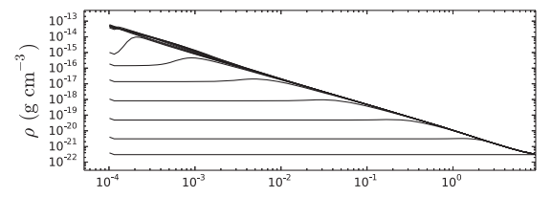
Predictions of Murray and Chang 15 I
Density is an attractor solution for small r
Murray & Chang 2015

Slide 16
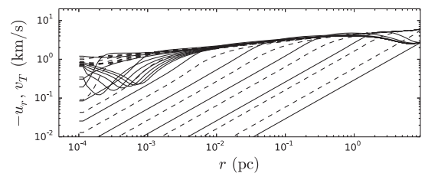
Predictions of Murray and Chang 15 II
Velocity scaling for large and small r
Murray & Chang 2015

Slide 17
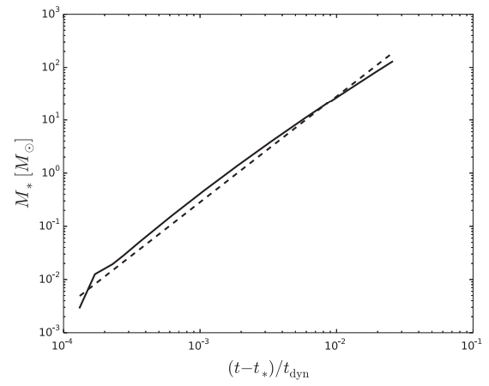
Predictions of Murray and Chang 15 III
Mass in stars scales like t²
t² scaling
Murray & Chang 2015
Notes:
Figure 7 Murray & Chang 2015.
The solid line is their numerical simulations. Note that they are low resolution
The dashed line is their prediction from the above equation.

Slide 18
Numerical Simulations to test those theories
Box L = 16pc H₂, ρ = 3x10⁻²² gcm⁻³,
c_{s} = 0.264 kms⁻¹
M ~ 18,000 solar masses, T ~ 17 Kelvin
Solenoidal stirring on 1 < kL < 2 ~ (8pc scale)
AMR from 128 cell root grid to 32k cells effective resolution of 100 AU

Slide 19
Results I
Filamentary structure (an old result)
(massive) star forming regions in the simulation are never in hydrostatic equilibrium
Does not look like Shu, Myers and Fuller, or McKee and Tan
Recover Larson’s size-linewidth relation, and deviations from it in collapsing regions
In other words, we see adiabatic heating of the turbulence
Notes:
Simplify

Slide 21
Results I
Filamentary structure (an old result)
(massive) star forming regions in the simulation are never in hydrostatic equilibrium
Does not look like Shu, Myers and Fuller, or McKee and Tan
Recover Larson’s size-linewidth relation, and deviations from it in collapsing regions
In other words, we see adiabatic heating of the turbulence
Notes:
Simplify

Slide 23
Results I
Filamentary structure (an old result)
(massive) star forming regions in the simulation are never in hydrostatic equilibrium
Does not look like Shu, Myers and Fuller, or McKee and Tan
Recover Larson’s relation at large scales, and small scales away from massive star forming regions and deviations from it in massive collapsing regions
In other words, we see adiabatic heating of the turbulence
Notes:
Interpret this as adiabatic heating a la Robertson and Goldreich

Slide 24
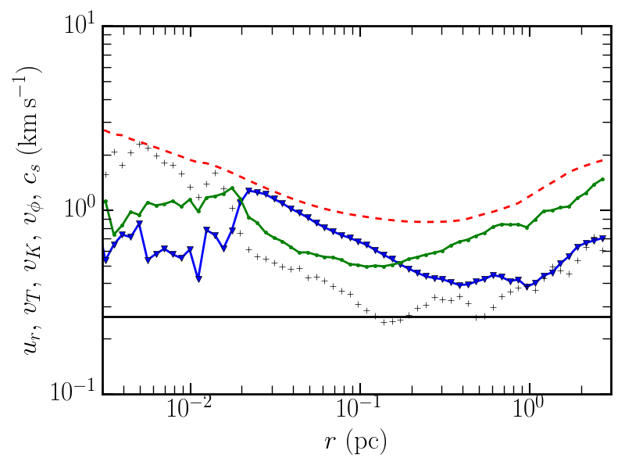

Slide 25
Adiabatic Heating in Turbulence
Robertson & Goldreich 2012

Slide 27
Results II
Find an attractor for the density profile ρ(r,t)→ρ(r) for rd<r<r*(t)
Disks form first then stars
Disks are around Q = 1, cycle around marginal stability over time
Find that the mass in stars goes like time squared:
Notes:
Simplify

Slide 29
Results II
Find an attractor for the density profile ρ(r,t)→ρ(r) for rd<r<r*(t)
Disks form first then stars
Disks are around Q = 1, cycle around marginal stability over time
Find that the mass in stars goes like time squared:
Notes:
Simplify

Slide 30
The Stellar Disk
Notes:
Its roughly the same size that corresponds to the uptick in the density.

Slide 31
Results II
Find an attractor for the density profile ρ(r,t)→ρ(r) for rd<r<r*(t)
Disks form first then stars
Disks are around Q = 1, cycle around marginal stability over time
Find that the mass in stars goes like time squared:
Notes:
Simplify

Slide 32
Hydro - SFE
Notes:
This is a very important point and I want to explain why it goes like t2

Slide 33
Why does M(t) ≈ t²?
Density is constant (independent of time) at small r
Infall velocity scales with mass
And so:
Notes:
This says that within two free-fall times most the gas in the box would be accreted.
Now that M ~ t2, this scaling can’t go on indefinitely, as this would eat the GMC within a couple free-fall times

Slide 34
What stops M(t)=t²?
Turbulence does not produce slow star formation
How about feedback?
Protostellar Jets
Stellar Winds
Supernovae
Radiative Feedback
I examine the effect of protostellar jets
have been proposed to regulate star formation
Notes:
Tie back to the global rate of 2%\
Protostars are seen to have jets, so we mimic those in the simulations
It has been suggested that the feedback can regulate star formation.
We picked a jet momentum that is consistent with observation. We eject a specified fraction of the accreted mass.

Slide 35
Simulating Protostellar Jets
The jet ejects a fraction of mass (f_jet) that would otherwise be accreted onto the star
The jet momentum is chosen to match observed values
Notes:
J-fet free parameter, fiducial value of 1/3
Velocity is roughly 40 km/s

Slide 36
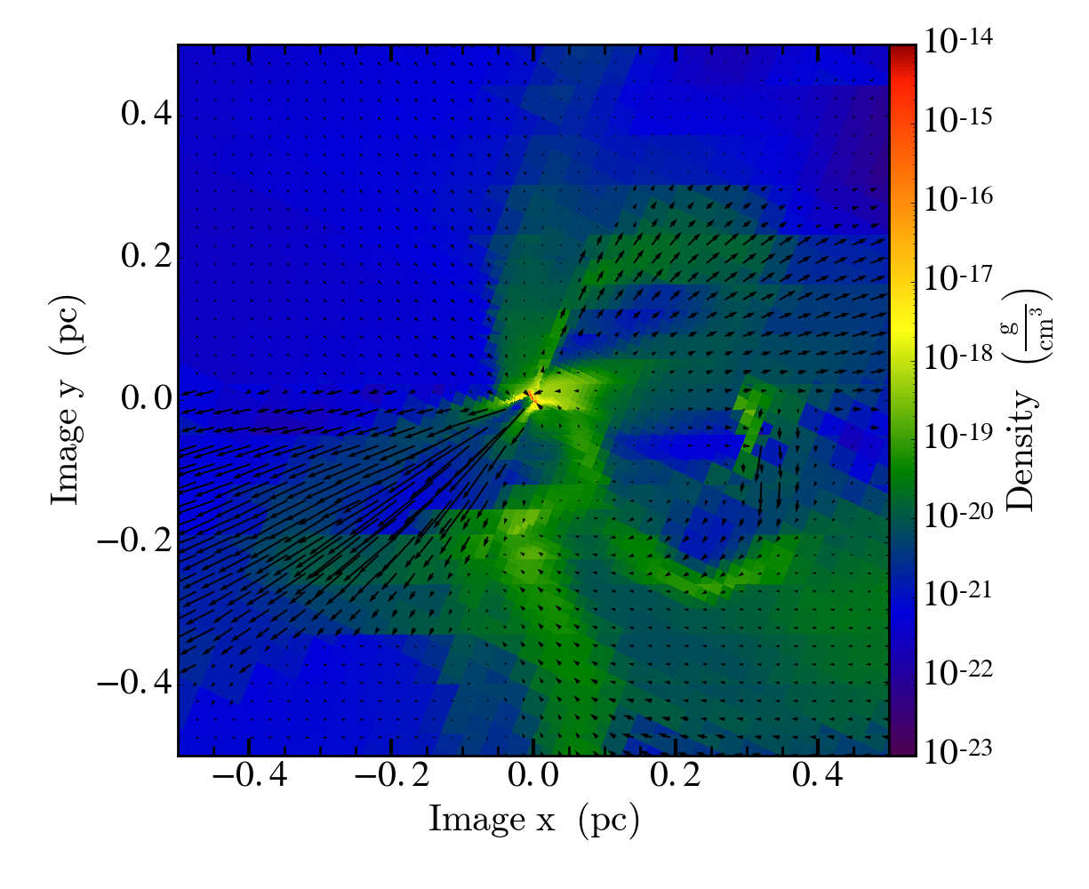

Slide 38
Protostellar Feedback & Hydro - Density
Protostellar jet feedback
HD

Slide 39
Star Formation efficiency
Protostellar jet feedback
HD
Notes:
Note that it goes like M(t) \propto (1-f_jet) ( t* - t)^2
Subsequent groups have done work to verify this, flip to LI et al.

Slide 40
Jet SFE vs m_jet
Notes:
Comparison keeping jet momentum deposition the same, varying only f_jet, the fraction of the mass ejected.
Free parameter f_jet, we vary f_jet to see what the affect it has on the proflie.

Slide 41
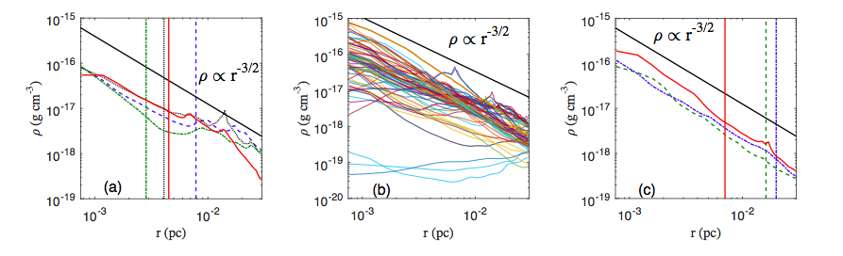
Li et al. 2017
Notes:
These results are now being reported on in other simulations – Pak Shing Li, Richard Klein, & Chris McKee
Simulations include MHD, Jets, winds? And Radiation.

Slide 42
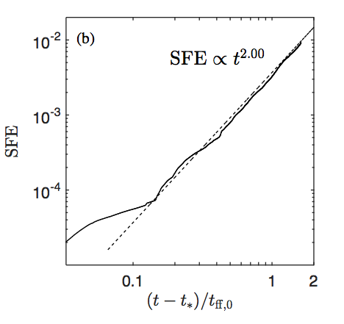
Li et al. 2017
Notes:
These results are now being reported on in other simulations – Pak Shing Li, Richard Klein, & Chris McKee
They did not look at the turbulent or infall velocities.
They reproduced my results, after my work was published.

Slide 43
Implications
Density is attractor solution -> lifetime of the observed structures is not the same as the local dynamical time
M(t) ~ t² -> large variation in SFE
v(r,t) -> deviation from Larson @ small scales,
Explains observations of Plume et al, Caselli and Myers
Also observable with ALMA.
Disk arise spontaneously from turbulent fluctuations
Notes:
Lifetime will be longer than (in many cases much longer than) the local dynamical time
ALMA has good resolution, so should be able to see this.
Disk -> all we mean is there is some net angular momentum

Slide 44
Conclusion I
v(r,t) -> deviation from Larson @ small scales,
Explains observations of Plume et al, Caselli and Myers
Old result - Disks arise spontaneously from turbulent fluctuations

Slide 45
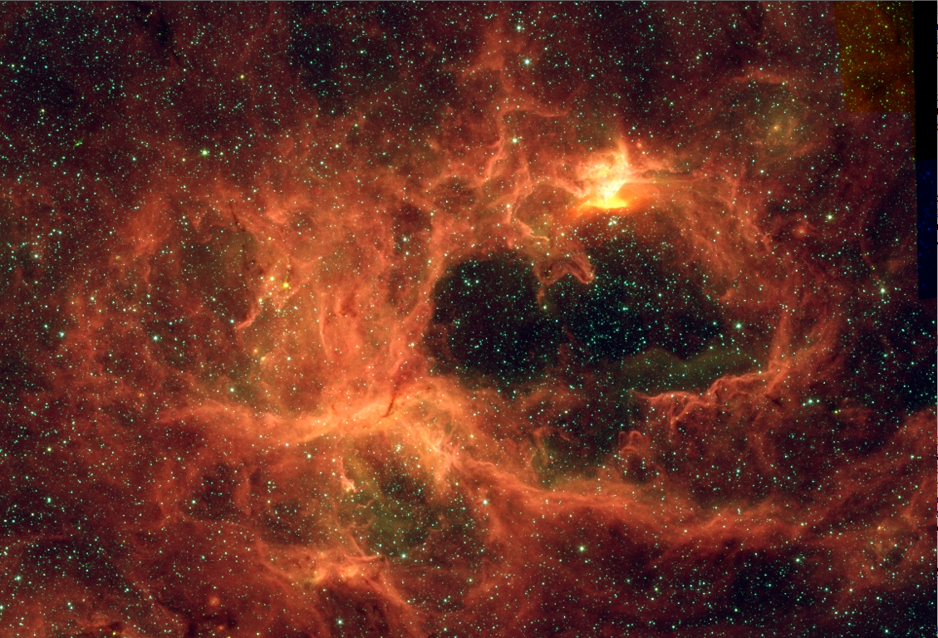
Conclusion II
Density is attractor solution -> lifetime of the observed structures is not the same as the local free-fall time
M(t) ~ t² -> large variation in SFE
SFR starts slow but accelerates with time
Notes:
The Stars in this image do change the density structure, but these are 100 solar mass stars (3 of them) (which we don’t look at stars that big)
Didn’t follow it till we reached those masses. (no cpu time)
PISMiS 24 NGC 6357

Slide 46
Future Work
Numerically:
Inclusion of Magnetic fields
Feedback
Radiative transfer
Stellar Winds
Supernovae
Radiative Feedback
Notes:
The Stars in this image do change the density structure, but these are 100 solar mass stars (3 of them) (which we don’t look at stars that big)
Didn’t follow it till we reached those masses. (no cpu time)
PISMiS 24 NGC 6357
Supernovae, seem to be too late

Slide 47
Run of Density with Magnetic Fields
HD
MHD

Slide 48
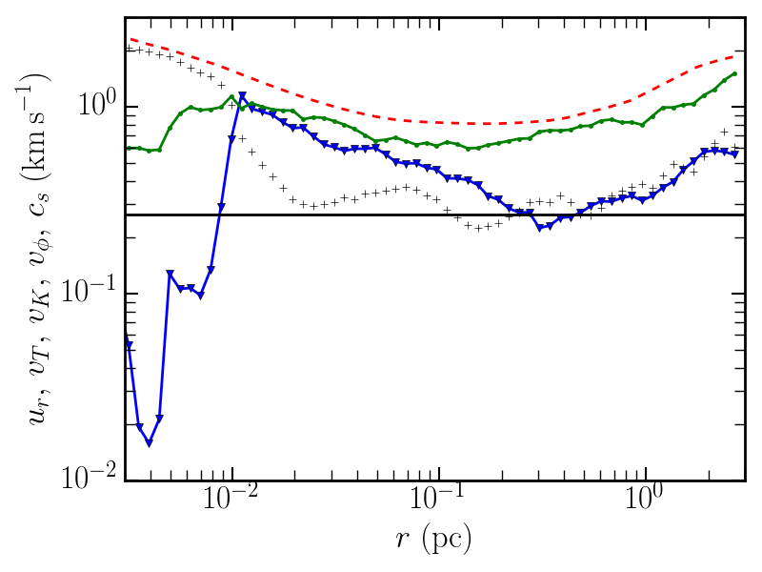
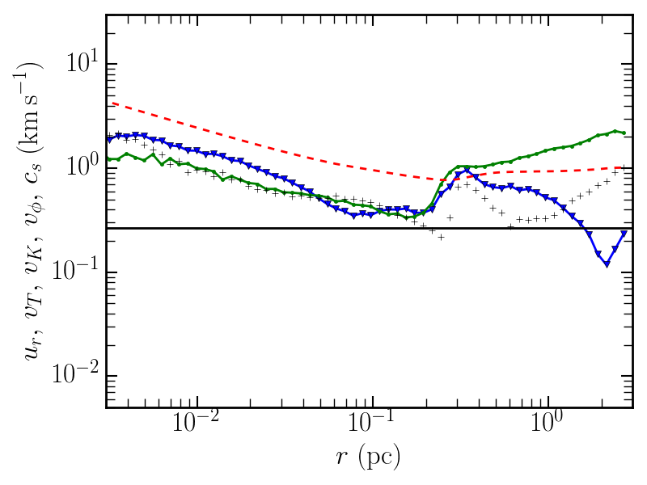
Velocities
Protostellar jet feedback
MHD

Slide 49
SFE
Protostellar jet feedback
MHD

Slide 50
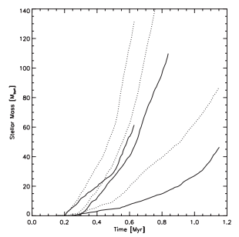
Wang et al. 2010
Notes:
From Upper left to lower right are models for HD, MHD, and MHD & winds
Dotted line is total mass, solid line is most massive star.

Slide 51
Larson; Penston; Shu Solution eqns

Slide 52
Myers & Fuller; McLaughlin & Pudritz; McKee & Tan Solution eqns

Slide 53
Breakup of Turbulent Velocity

Slide 54
The Spherical Inflow Assumption
Notes:
Plot on left says that ~50% of the total m_dot comes in from density spots from density spots 3xrho_avg or less than that.
Plot on the right says that ~90% of the total inflow comes from the entire sky, with the remaining ~50% of mass coming from 10% of the sky (filament).

Slide 55
Velocity Profile Agregate

